Slide 1
Variable-wise and Term-wise Recentering
Doug Hemken
October 2015

Slide 2
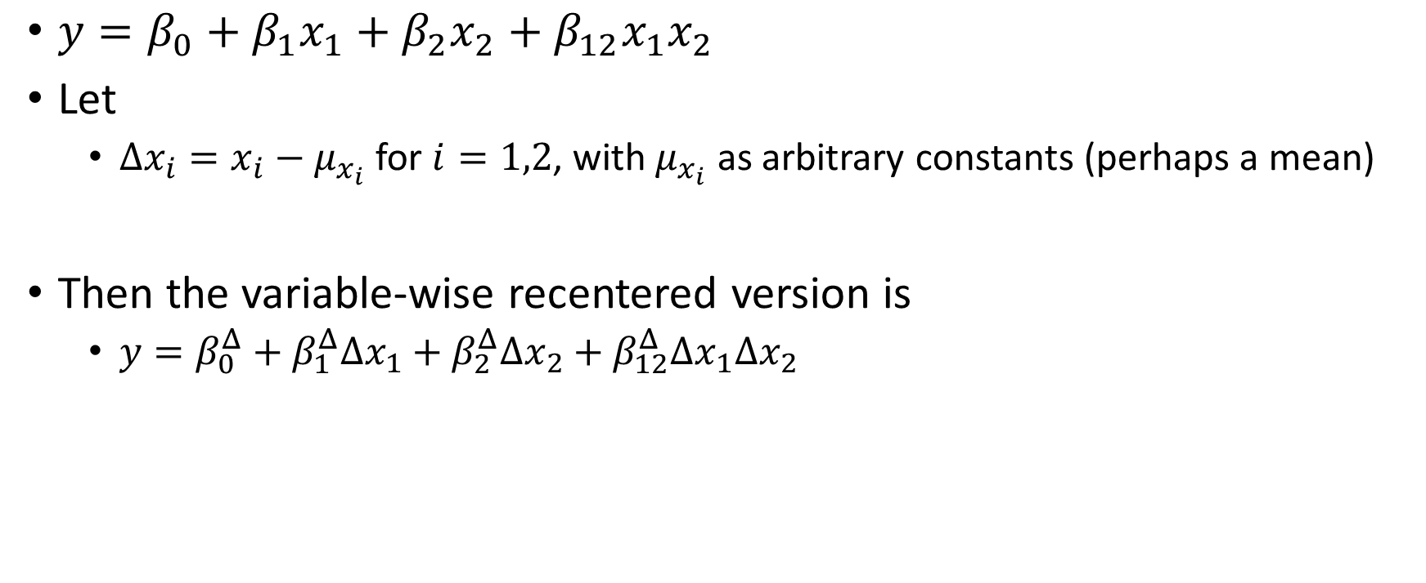
Variable-wise recentering
$y=β_{0}+β_{1}x_{1}+β_{2}x_{2}+β_{12}x_{1}x_{2}$
Let
$Δx_{i}=x_{i}−μ_{x_{i}}$ for $i=1,2$, with $μ_{x_{i}}$ as arbitrary constants (perhaps a mean)
Then the variable-wise recentered version is
$y=β_{0}^{Δ}+β_{1}^{Δ}Δx_{1}+β_{2}^{Δ}Δx_{2}+β_{12}^{Δ}Δx_{1}Δx_{2}$

Slide 3
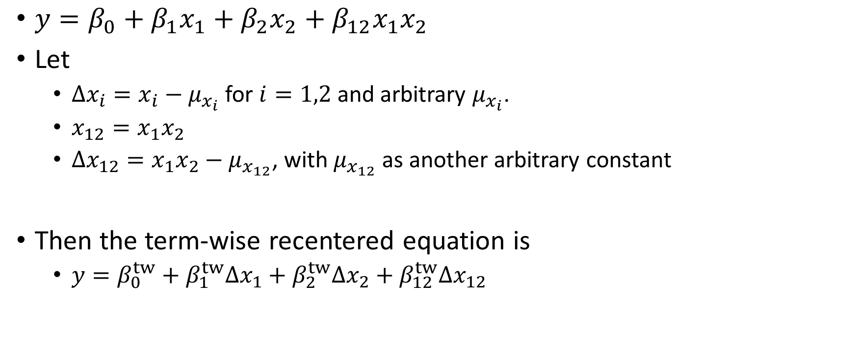
Term-wise recentering
$y=β_{0}+β_{1}x_{1}+β_{2}x_{2}+β_{12}x_{1}x_{2}$
Let
$Δx_{i}=x_{i}−μ_{x_{i}}$ for $i=1,2$ and arbitrary $μ_{x_{i}}$.
$x_{12}=x_{1}x_{2}$
$Δx_{12}=x_{1}x_{2}−μ_{x_{12}}$, with $μ_{x_{12}}$ as another arbitrary constant
Then the term-wise recentered equation is
$y=β_{0}^{tw}+β_{1}^{tw}Δx_{1}+β_{2}^{tw}Δx_{2}+β_{12}^{tw}Δx_{12}$

Slide 4
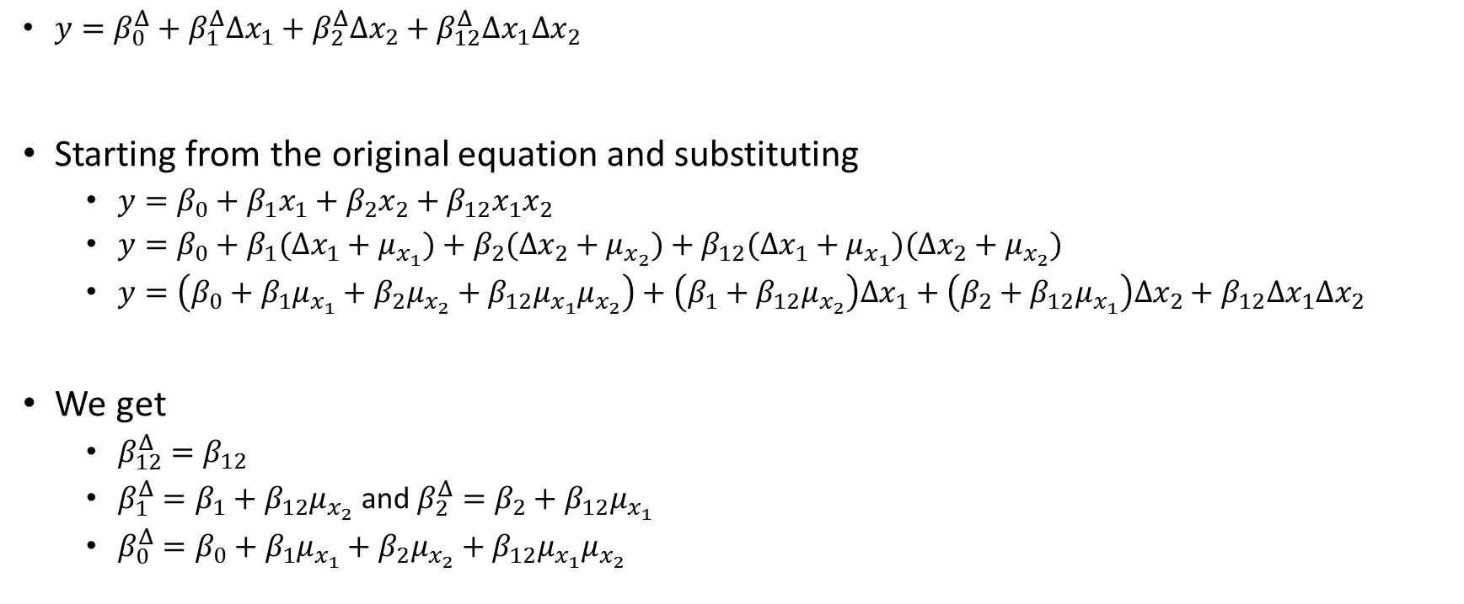
Deriving variable-wise parameters
$y=β_{0}^{Δ}+β_{1}^{Δ}Δx_{1}+β_{2}^{Δ}Δx_{2}+β_{12}^{Δ}{Δx}_{1}{Δx}_{2}$
Starting from the original equation and substituting
$y=β_{0}+β_{1}x_{1}+β_{2}x_{2}+β_{12}x_{1}x_{2}$
$y=β_{0}+β_{1}(Δx_{1}+μ_{x_{1}})+β_{2}(Δx_{2}+μ_{x_{2}})+β_{12}(Δx_{1}+μ_{x_{1}})(Δx_{2}+μ_{x_{2}})$
$y=\left(β_{0}+β_{1}μ_{x_{1}}+β_{2}μ_{x_{2}}+β_{12}μ_{x_{1}}μ_{x_{2}}\right)+\left(β_{1}+β_{12}μ_{x_{2}}\right)Δx_{1}+\left(β_{2}+β_{12}μ_{x_{1}}\right)Δx_{2}+β_{12}Δx_{1}Δx_{2}$
We get
$β_{12}^{Δ}=β_{12}$
$β_{1}^{Δ}=β_{1}+β_{12}μ_{x_{2}}$ and $β_{2}^{Δ}=β_{2}+β_{12}μ_{x_{1}}$
$β_{0}^{Δ}=β_{0}+β_{1}μ_{x_{1}}+β_{2}μ_{x_{2}}+β_{12}μ_{x_{1}}μ_{x_{2}}$

Slide 5
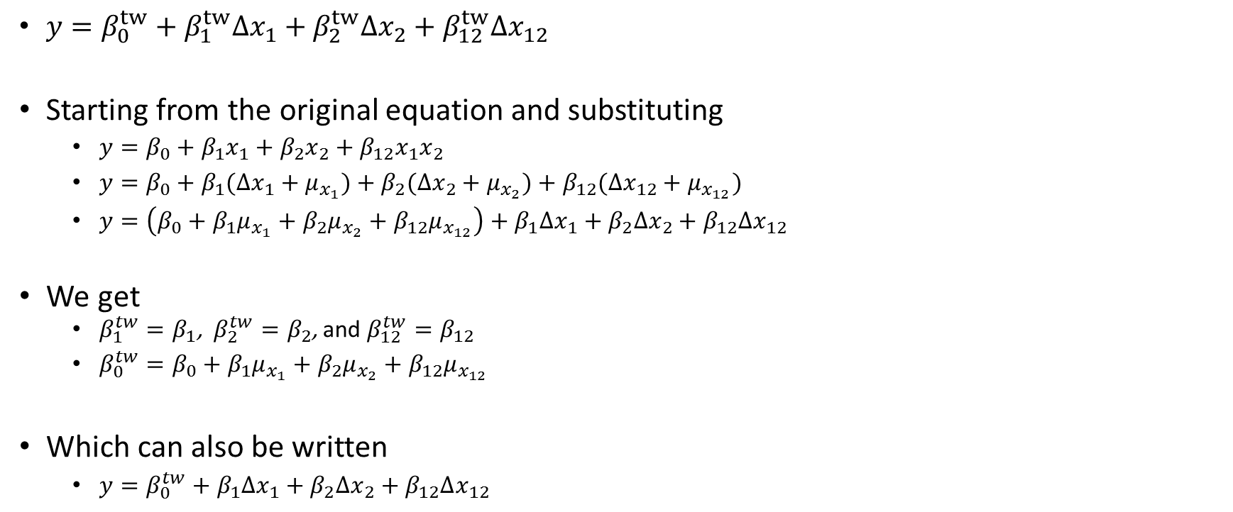
Deriving term-wise parameters
$y=β_{0}^{tw}+β_{1}^{tw}Δx_{1}+β_{2}^{tw}Δx_{2}+β_{12}^{tw}Δx_{12}$
Starting from the original equation and substituting
$y=β_{0}+β_{1}x_{1}+β_{2}x_{2}+β_{12}x_{1}x_{2}$
$y=β_{0}+β_{1}(Δx_{1}+μ_{x_{1}})+β_{2}(Δx_{2}+μ_{x_{2}})+β_{12}(Δx_{12}+μ_{x_{12}})$
$y=\left(β_{0}+β_{1}μ_{x_{1}}+β_{2}μ_{x_{2}}+β_{12}μ_{x_{12}}\right)+β_{1}Δx_{1}+β_{2}Δx_{2}+β_{12}Δx_{12}$
We get
$β_{1}^{tw}=β_{1}$, $β_{2}^{tw}=β_{2}$, and $β_{12}^{tw}=β_{12}$
$β_{0}^{tw}=β_{0}+β_{1}μ_{x_{1}}+β_{2}μ_{x_{2}}+β_{12}μ_{x_{12}}$
Which can also be written
$y=β_{0}^{tw}+β_{1}Δx_{1}+β_{2}Δx_{2}+β_{12}Δx_{12}$

Slide 6
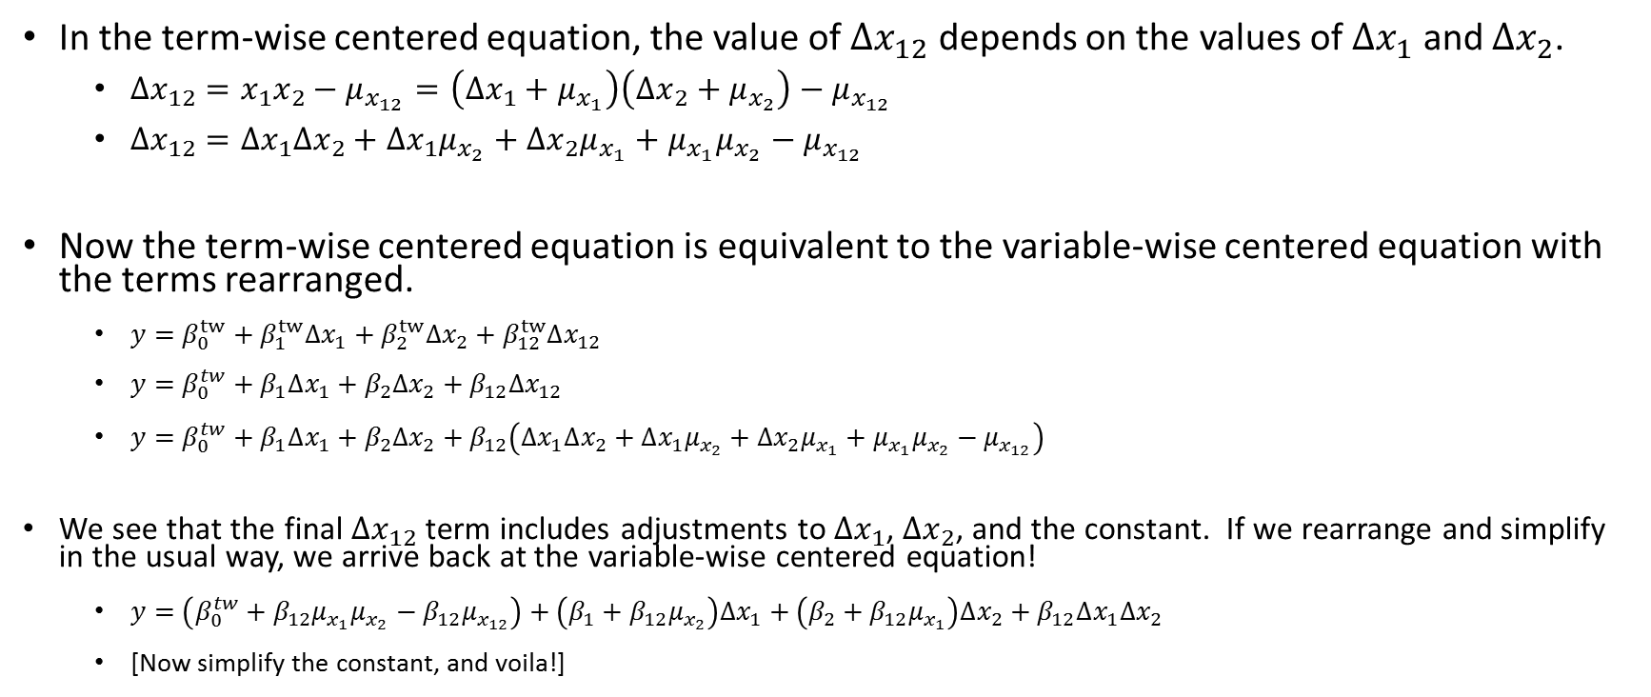
Using the term-wise equation
In the term-wise centered equation, the value of $Δx_{12}$ depends on the values of $Δx_{1}$ and $Δx_{2}$.
$Δx_{12}=x_{1}x_{2}−μ_{x_{12}}=\left(Δx_{1}+μ_{x_{1}}\right)\left(Δx_{2}+μ_{x_{2}}\right)−μ_{x_{12}}$
$Δx_{12}=Δx_{1}Δx_{2}+Δx_{1}μ_{x_{2}}+Δx_{2}μ_{x_{1}}+μ_{x_{1}}μ_{x_{2}}−μ_{x_{12}}$
Now the term-wise centered equation is equivalent to the variable-wise centered equation with the terms rearranged.
$y=β_{0}^{tw}+β_{1}^{tw}Δx_{1}+β_{2}^{tw}Δx_{2}+β_{12}^{tw}Δx_{12}$
$y=β_{0}^{tw}+β_{1}Δx_{1}+β_{2}Δx_{2}+β_{12}Δx_{12}$
$y=β_{0}^{tw}+β_{1}Δx_{1}+β_{2}Δx_{2}+β_{12}\left(Δx_{1}Δx_{2}+Δx_{1}μ_{x_{2}}+Δx_{2}μ_{x_{1}}+μ_{x_{1}}μ_{x_{2}}−μ_{x_{12}}\right)$
We see that the final $Δx_{12}$ term includes adjustments to $Δx_{1}$, $Δx_{2}$, and the constant. If we rearrange and simplify in the usual way, we arrive back at the variable-wise centered equation!
$y=\left(β_{0}^{tw}+β_{12}μ_{x_{1}}μ_{x_{2}}−β_{12}μ_{x_{12}}\right)+\left(β_{1}+β_{12}μ_{x_{2}}\right)Δx_{1}+\left(β_{2}+β_{12}μ_{x_{1}}\right)Δx_{2}+β_{12}Δx_{1}Δx_{2}$
[Now simplify the constant, and voila!]

